Slide 1

Linear regression
Prepared by: hisham abulfeilat

Slide 2
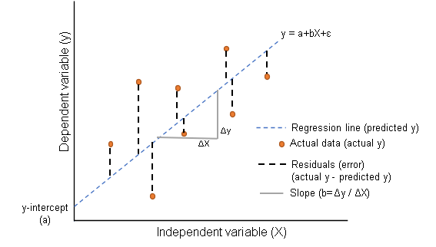
Linear regression
Linear Regression: is a regression model that measures the relationship between variables using a straight line.
Why is Linear Regression used?
To predict a specific value

Slide 3

Thank You!

